Slide 1
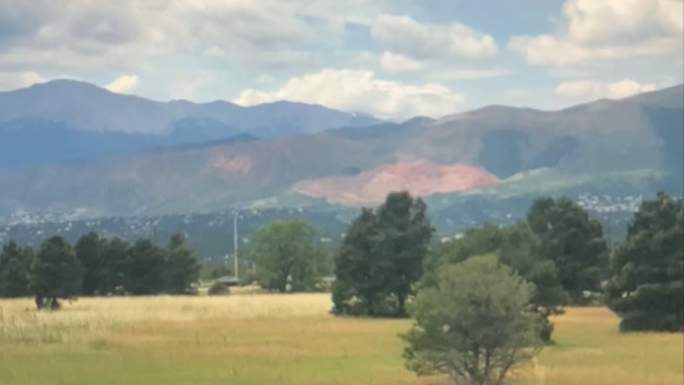
Commercial Photography Final
Ava Schrock

Slide 2
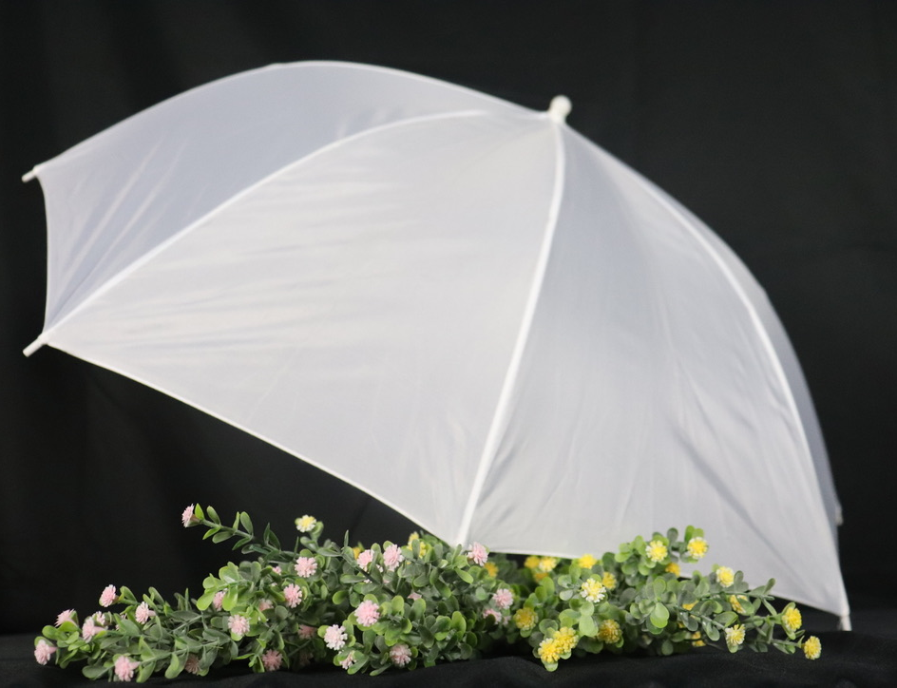
Still Life photos
About Me:
Hello, I’m Ava. I was born in Bradenton, Florida and my favorite hobbies include painting, photography, and reading. I have taken photography before in 7th grade, but I didn’t learn as much in that class as this one especially since the teacher barely ever made an appearance in class. I have enjoyed and learned much about photography in this short semester and I think my future photos will definitely turn out much better after taking this course.

Slide 3
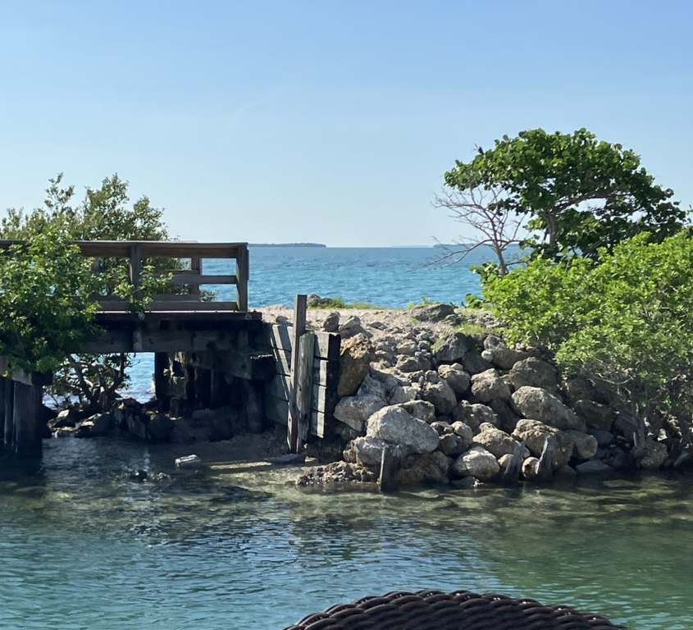
Documentary Project
My goal for this image was to use the great lighting to highlight the different textures in this photo
The composition of this image shows the composition of this photo is unique because of the color contrast and layers of color

Slide 4
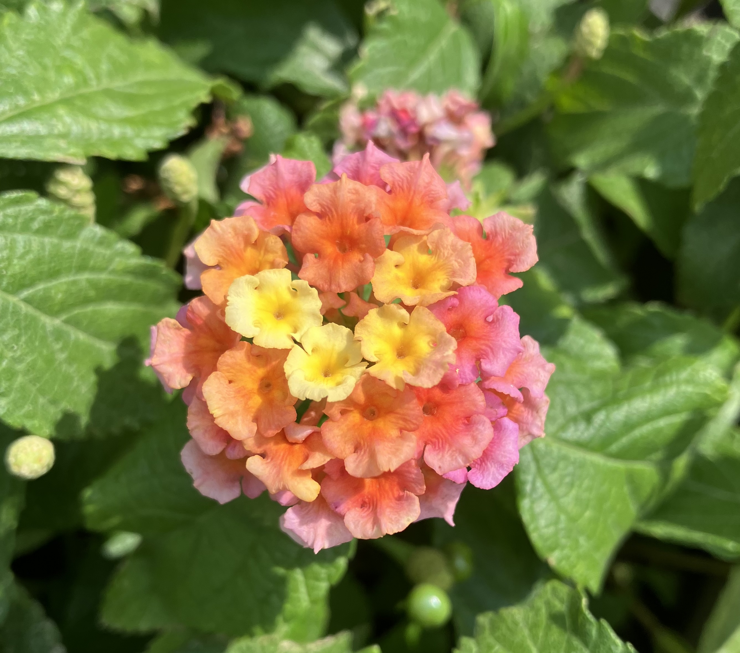
Composition Photos
My goal for this image was to highlight the unique colors and the smaller flowers coming together to create a larger one
This photo is unique due to the way the color fades into the other colors and its brightness

Slide 5
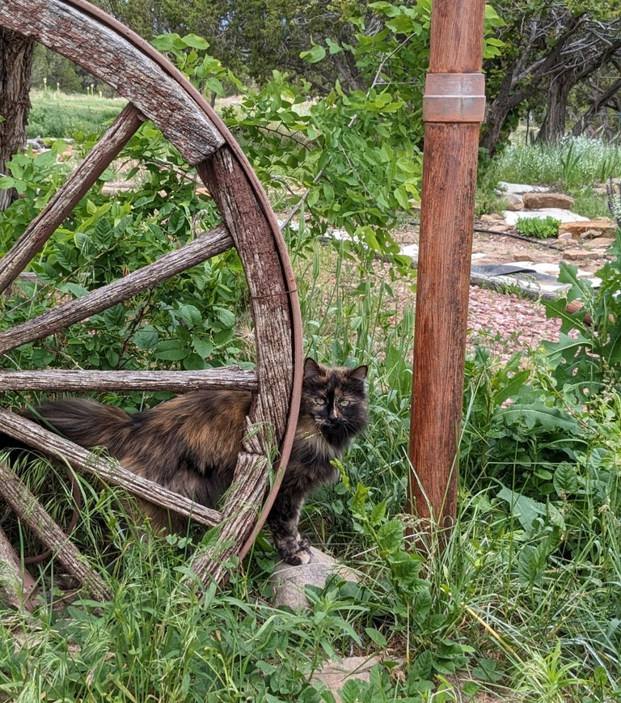
Composition photos
My goal for this photo was to use the brighter colors to bring the viewers’ attention to the subject, my cat and the wheel and pole which compliments her
This photo’s composition is unique because rather than using darker colors as the background to highlight the subject, I did it the other way around

Slide 6
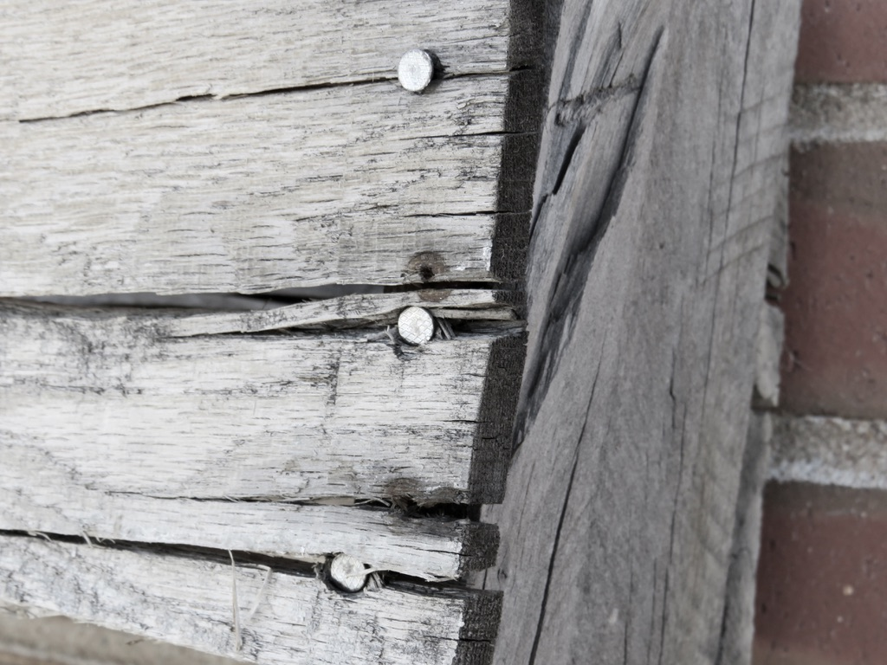
Texture photos
My goal for this photo was to get a clear shot of the textures and difference in textures throughout
This photo’s composition is unique because I got in close to a smaller area of the wood and included some brick in the background as a texture reference

Slide 7
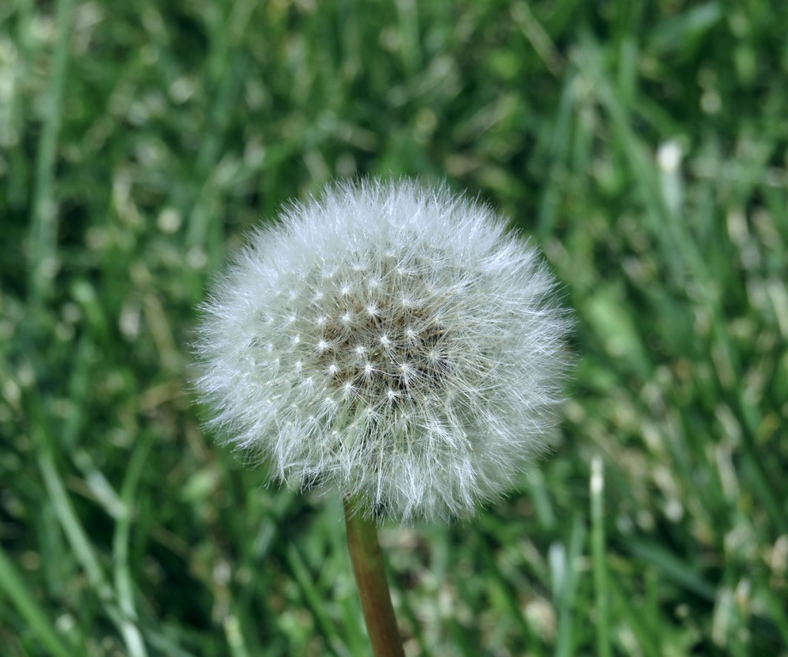
Texture photos
My goal for this photo was to capture the way the small fluffy seeds showed great texture and the detail
The composition of this photo is unique because of the color contrast that really makes the seeds and small details stand out

Slide 8
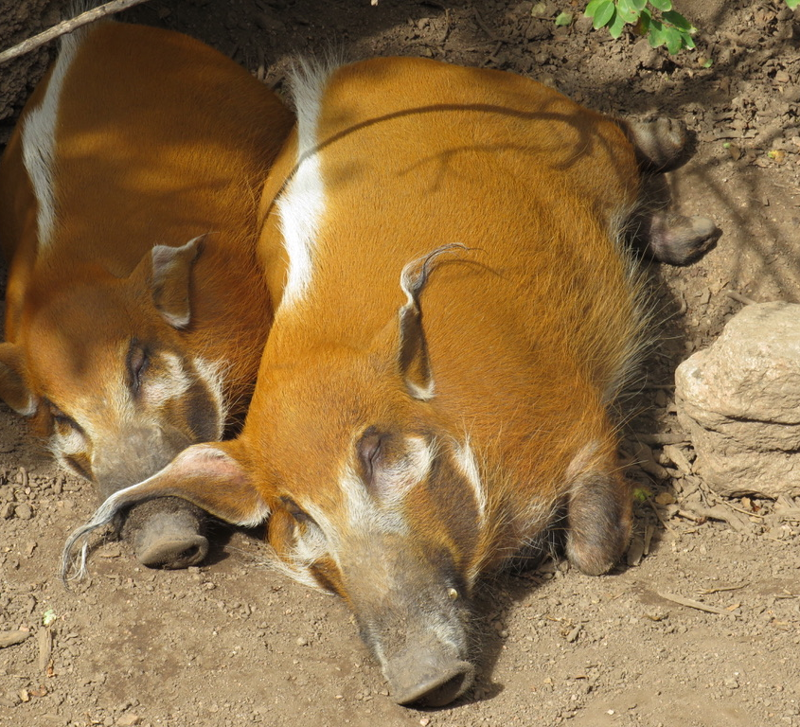
Zoo photos
My goal for this photo was to capture the gorgeous color of these hogs and their peacefulness
The composition of this photo is unique because of the way the picture depicts a very zoomed in shot of them

Slide 9
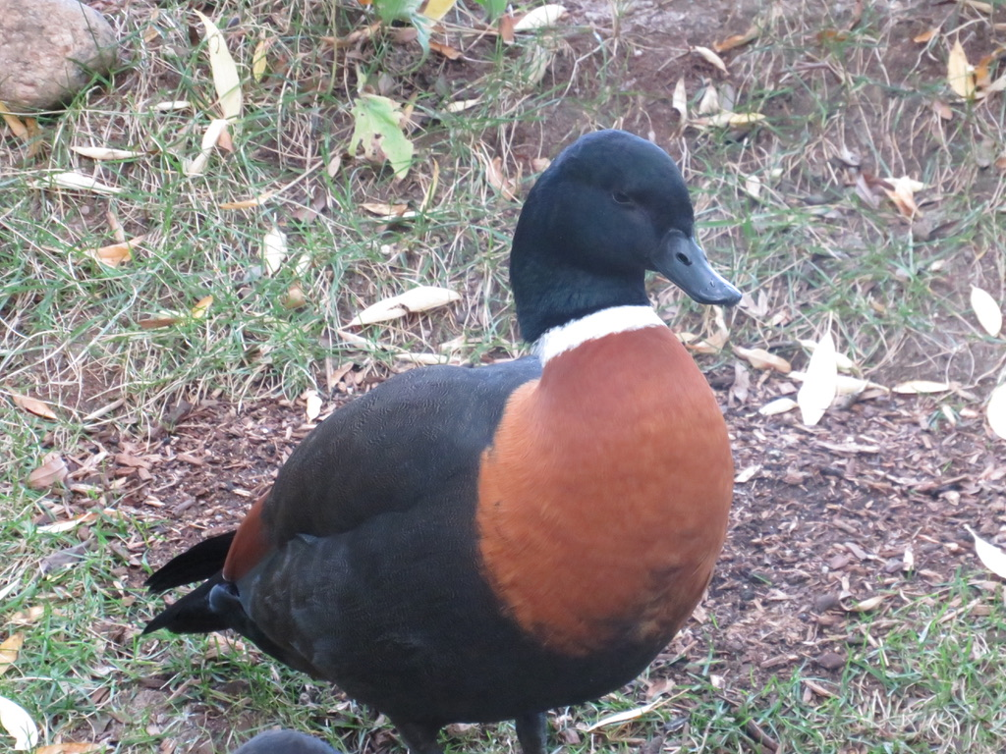
Zoo photos
My goal for this picture was to show the stark color contrast on the duck’s body
The composition of this photo is unique because of the color changes between the head and the neck

Slide 10
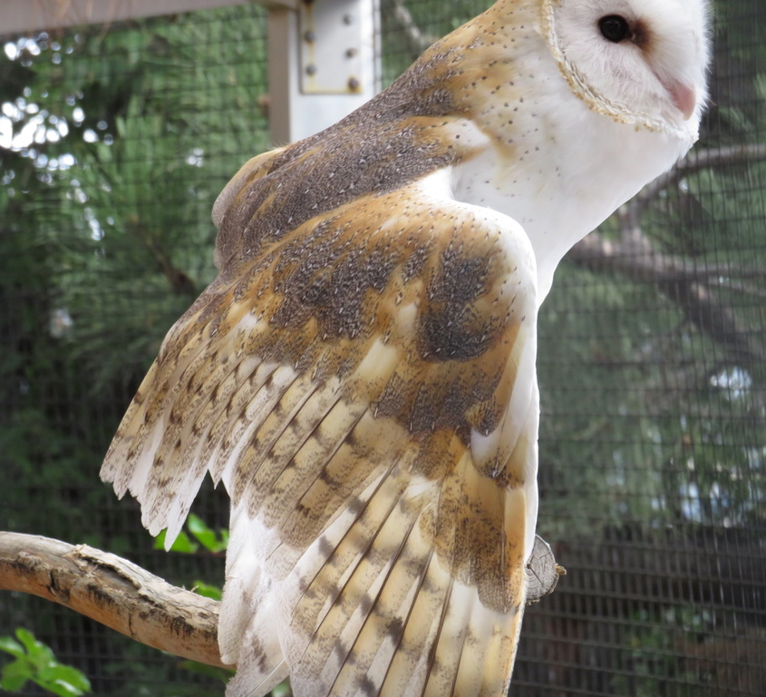
Zoo photos

Slide 11
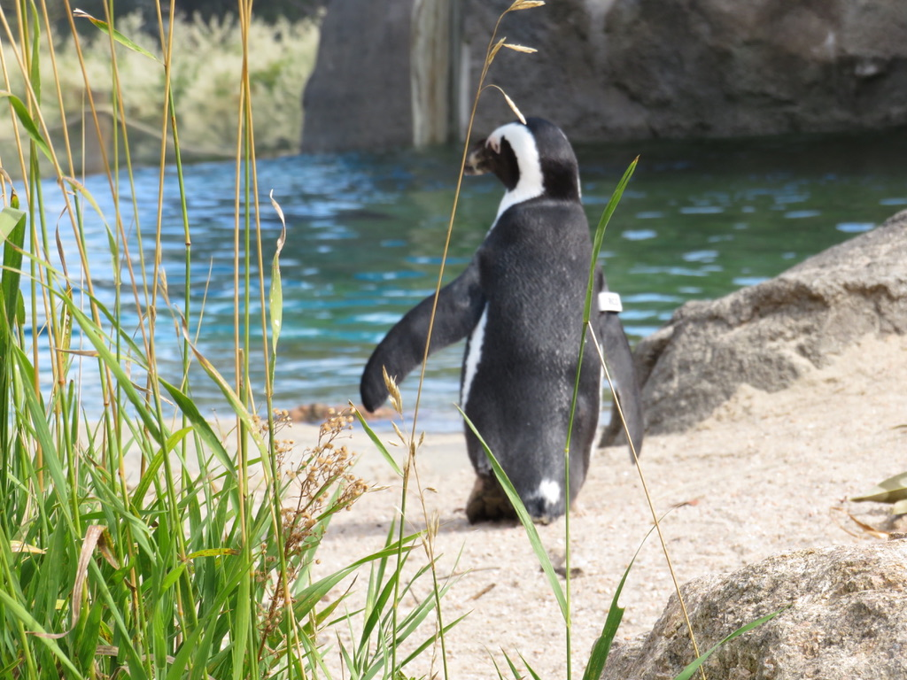
Zoo photos
My goal for this picture was to capture the penguin in a way that looked like it was in its natural habitat
The composition of this photo is unique because of the way I got the penguin so well posed and positioned that it looks almost natural

Slide 12
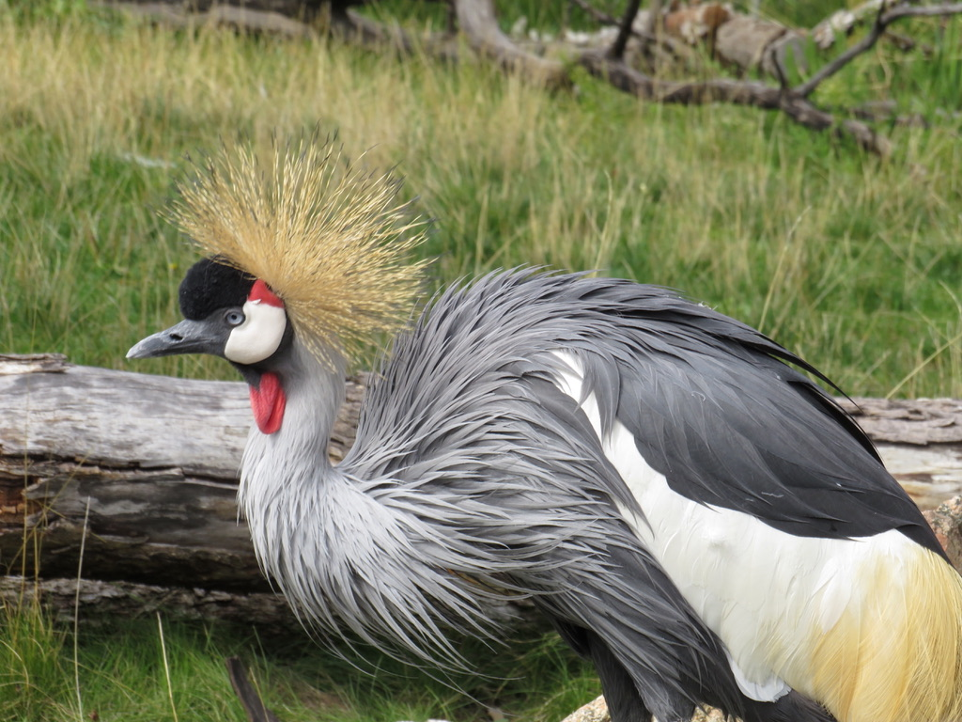
Zoo photos
My goal for this photo was to capture the bird in a position so you could see all its features and colors
The composition of this photo is unique because of the perfectly posed bird

Slide 13
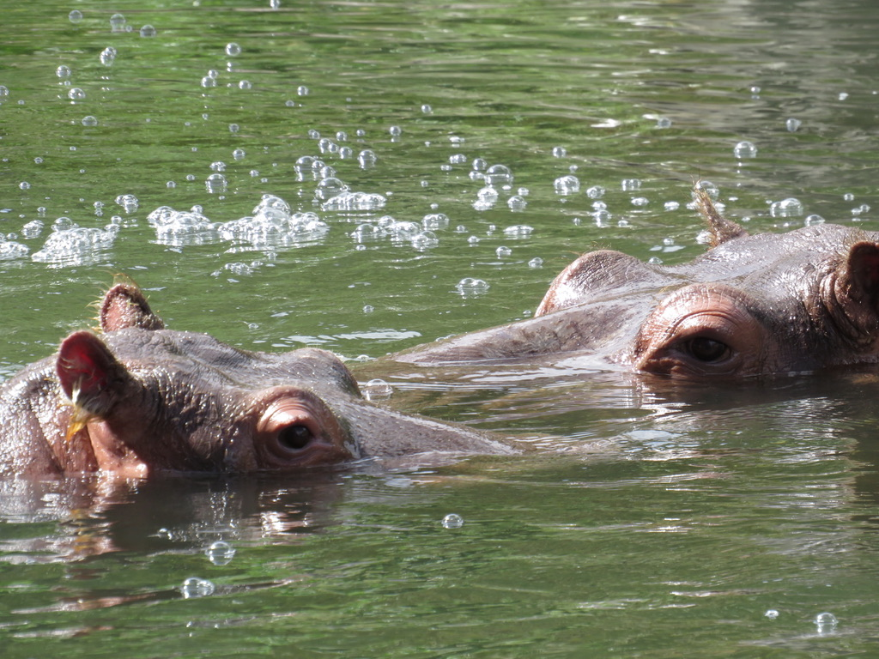
Zoo photos
My goal for this photo was to get a shot of the hippos looking friendly
The composition of this photo is unique because of the relaxed feeling it gives because of the hippos being together and the way the hippos are filling the frame

Slide 14
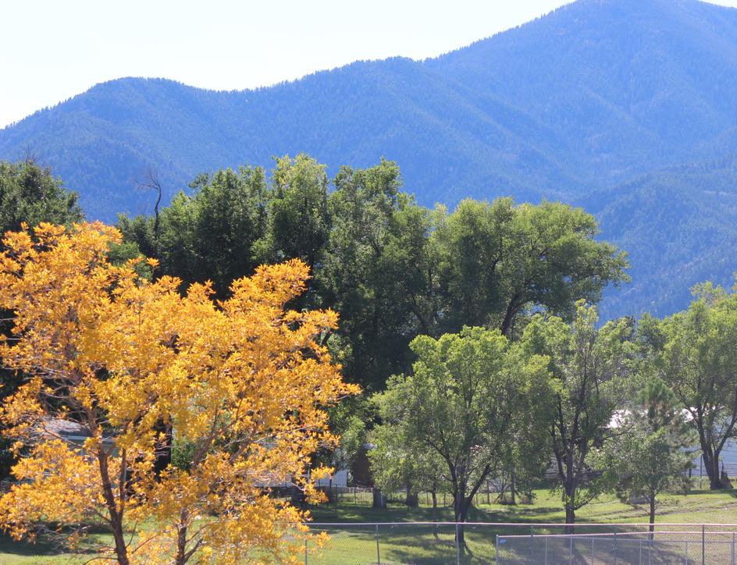
Grand landscape photos
My goal for this picture was to include color and texture into one landscape photo
The composition of this photo is unique because of the way there is only one bright yellow tree in the corner and the mountains are on the other side

Slide 15
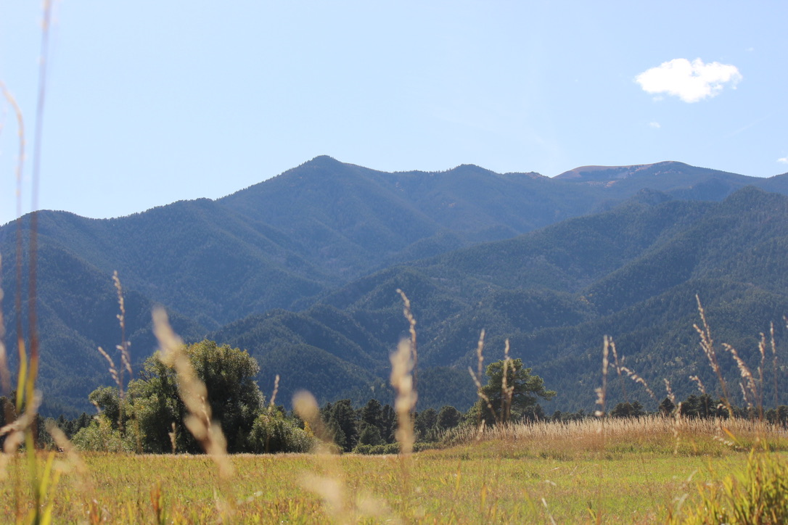
Grand landscape photos
My goal for this photo was to give a sense of depth by putting the plants in front of the mountains
The composition is unique because of the mountains being further up and clearer with the plants that are closer being more blurred out

Slide 16
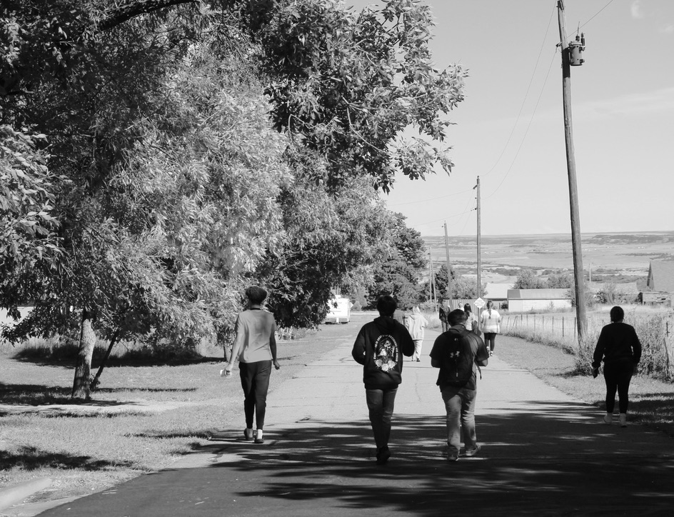
Grand landscape photos
My goal for this photo was to show a sense of friendship by taking a picture of people who are walking in a near straight line
The composition is unique because the people are more to the right and the trees take up the entire left side

